Slide 1
End of Capstone II
Grant
Presenters: Grant Saylor, Kyle Smith, Anthony Tran, Jiayi Xu

Slide 2

End of Capstone II
Grant
Presenters: Grant Saylor, Kyle Smith, Anthony Tran, Jiayi Xu

Slide 3
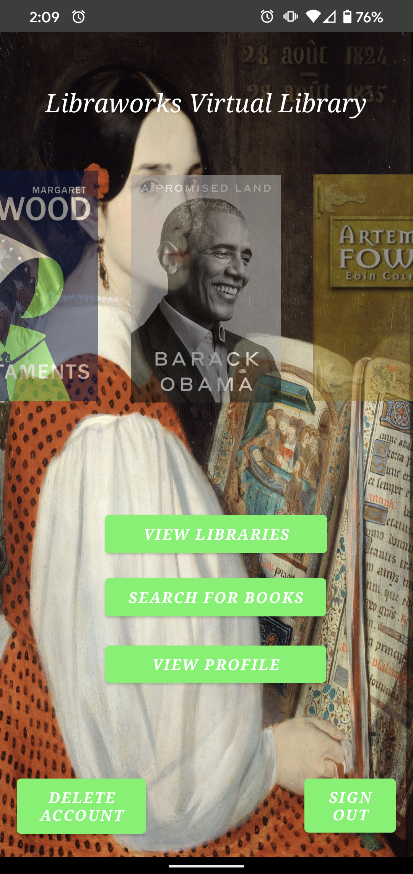
A Refresher on Virtual Library
Grant
Virtual Library is a software layer on top of existing free-little libraries in your neighborhood.
The app facilitates ease-of-use and a sense of connectedness.
Designed for Android in Kotlin
Speaker: Grant Saylor

Slide 4
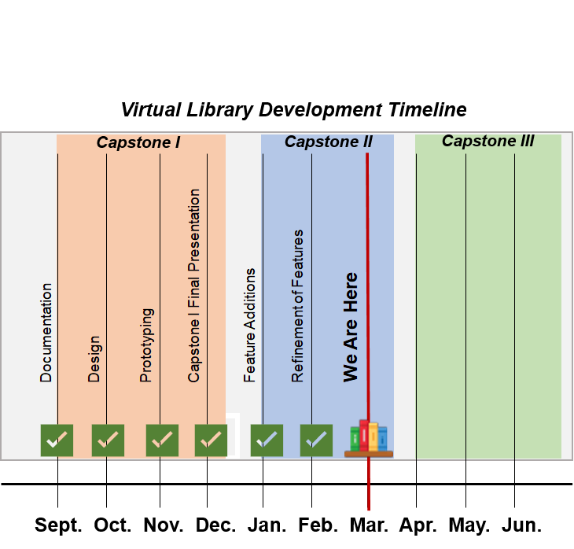
Where We Are in Development
Grant
Currently, development is nearing the end of large-feature implementation
The final refinement phase heading towards release is about to begin
Months of development have opened our eyes to mobile app development!
Speaker: Grant Saylor

Slide 5
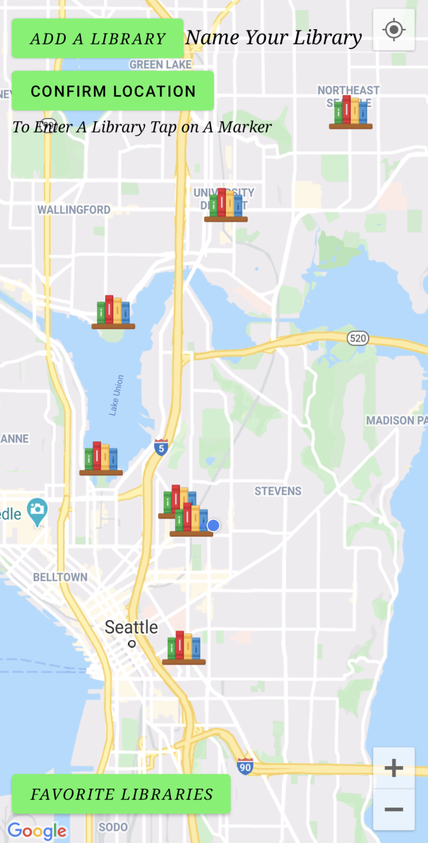
An Overview of New Technologies
Grant
Firebase Authentication
Event handling via asynchronous tasks
Experimentation with new and more complex Android-app layouts
A demo explaining all of these to follow...
Speaker: Grant Saylor

Slide 6
Demo: User Authentication and Maps
Grant
An easy and elegant way to browse or add a library
Safe and secure authentication via Firebase
Easily access your favorites
Speaker: Grant Saylor

Slide 7
Demo: Search Activity
Anthony
Asks user to type in a book title or substring of the title
App will sift through our Book database to match the book title to the user input
App will display 3 books at a time, with some relevant information
Forward and backwards button will flip through pages if multiple books match
Speaker: Anthony Tran
Notes:
Hi, My name is Anthony and I’m going to talk about the search functionality of our application. Our Virtual library application definitely needed to have a search function implemented so that it provides users with the greatest of ease and access when searching for books in our database. This is one of the key feature to searching for a particular book. To begin, the user is required to type in a book title to begin searching through our database.
(TYPES IN “THINK AGAIN”)
After typing a search input and then searching, the program performs an async task to check and match the search input to book titles in our Book Database. If there is a match then the screen will populate up to 3 of the search results that match the user input
( PRESSES SEARCH BUTTON)
As you can see, the screen the populates any books that match the search results. The book cover is shown as well as the title, author and its corresponding ISBN
We also implemented the search so that the capitalization of the search input does not matter, making it much easier for searching.
(TYPES IN “fOuR wINds” THEN PRESS SEARCH BUTTON)
Like previously, the book cover and information is populated, even though the title contains incorrect capitalization.
Here we can try another search input.
(TYPE IN “IN” IN THE SEARCH THE PRESS SEARCH RESULT)
Our search functionalities are implemented to allows us to search using substrings of potential titles. Here are the search results for “in”
If we press the forwards and backwards button at the bottom, then it will flip pages of search results.
(PRESS FORWARDS AND BACKWARDS WIN)
(CLICK A TEXT BOX WITH THE BOOK INFORMATION)TH 2 SECONDS IN BETWEEn
If we press on the text boxes, it will pop up a toast notification, which in the future will instead connect to other activities screens for further access and information.
Now lets try typing in some gibberish
(TYPE IN GIBBERISH AND PRESS SEARCH)
If there isn’t a match to anything in our database, then the application will send the user a notification that nothing was found, and wipe away previous books cover and information frpm prevopis searches
It’s still a work in progress but this is the current iteration of our search menu and its functionalities.
Now i’ll hand it over to Jiayi to talk about the library screen.

Slide 8
Demo: Library View
Jiayi
Books in each library (use intent)
Shows total books of each library
Books cover clickable: available books and total books of this book
Feature: make image scrollable or swipeable
Speaker: Jiayi Xu
Notes:
(Start from: Main Page)
Hi, this is Jiayi. I am here to talk about the Library View page.
For this page is to show each library’s information, like total books and copies of each book.
You can see the map button, Grant introduced this part before. Here is to show we can go through with Map and to see different libraries information.
When you click the library button, we use intent bundle to do data sync job.
(CLICK VERY RIGHT LIBRARY)
As you can can see, the library’s name shows on top of the screen, and also you can see the Total books there. This total books present the total books of this library, each library will have the same functionality.
Now, you can see there have three books in this library.
For each book, you can c
lick the books cover to see how many available copies and how many total copies of this book.
(CLICK BOOK’S COVER: to show available copies and total copies)
If user found the book in this library, they can click the “Begin Checkout” button to do check out, and it will jump to the barcode scanner screen.
(CLICK: Begin Checkout)
For the feature change, we need to change the image scrollable or swipeable to make this page more flexible, and present more covers for user. Our group still working on this.
I will hand over to Kyle to introduce barcode scanner.

Slide 9
Demo: Barcode Scanner
Kyle
Activity auto-detects if you came from a user profile or a library
Flip the switch to check the book in or out
Once ISBN is scanned, backend works to find book info
Once user clicks checkout button, the data is stored in Firebase
Speaker: Kyle Smith
Notes:
Hello everyone, this is Kyle, and I’m going to talk about our check in/out process. This activity is designed to handle a few different situations, depending on whether the user is trying to update a library circulation, or their personal collection, whether the book is being returned or checked out of a library, or even if that book is new to our database or not. When the user arrives at this scan screen, our code detects what activity the user just came from. If the user was previously at a library screen, that activity will pass the ID of the library here to the scanning screen for the checkout process. If no library ID was passed, then we know the user arrived here from their user profile screen, and that they are going to be adding a book to their personal collection.
(Move mouse down near the switch, maybe toggle it back and forth. Leave it on Check-in)
We can use this switch on the page to indicate whether the user is attempting to check out a book, or return a book that they have previously checked out. This flips the state of a boolean that will adjust the way we update our database when the user hits the checkout button, which I discuss later.
(Gesture to the camera view)
This black box on the screen inside of the gold frame is normally where we would be seeing the view of the camera on the device, but since we are using a phone emulator for this demo, it doesn’t display anything. On actual hardware we would use this to scan the barcode on the back of the book to obtain the book’s 13-digit ISBN, which we then use to grab information from a book API. Since this is on an emulator, we have an ISBN currently hard coded so we can see the checkout process despite not having a camera. As soon as the barcode is scanned and we obtain that ISBN, we read through our database and check if that book is already in our records. If it is not, we utilize the API to grab some information about it, such as the cover image of the book, the title, the author, and the publication date. If the book is part of our DB already, we simply read a few of the attributes we want to display during checkout process, such as the title and cover. Once the information is obtained, either from the API or from our DB, they are stored in local variables, waiting to be pushed or updated in the DB. We wait to make any changes to the DB until the user clicks the checkout button below, confirming that this book is the one the user is wanting to complete the process with.
(Move mouse down to checkout button, click it sometime while I’m talking)
Once the user is ready, they can hit the checkout button and the information is sent to our database on Firebase. Depending on whether this information is going to the library or user profile section, which the program determined earlier, the information will go to our database. For the library portion, that means it will read the current inventory of that particular book and adjust it accordingly. If the book is brand new and not in our records, that information is also sent to that section of our database, to make any future transactions with that title more efficient. If this book was being added to the user collection, then it pushes that data to that location instead of the library part of our database. As you saw, when the user clicks the button, we display the cover and send a toast notification as well to confirm to the user that the information was sent. They can now safely back out of the screen.

Slide 10
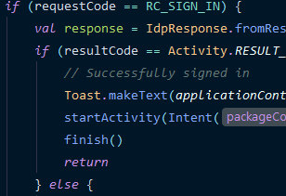
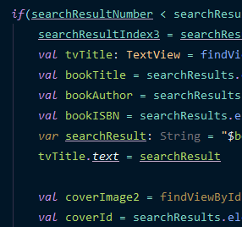
Future Work
Kyle
Certain screens need to be scrollable (instead of utilizing button clicks.)
Add parallax scrolling and dynamic book covers to the title screen
Tidying up visual design
Capability to checkout from user personal-collections instead of just from libraries.
Speaker: Kyle Smith

Slide 11
Development Tools Sources:
Kyle
Firebase: https://firebase.google.com/
Android Studio: https://developer.android.com/studio
Maps SDK: https://console.developers.google.com/apis/library/maps-android-backend.googleapis.com
ISBN Tutorial: https://medium.com/analytics-vidhya/creating-a-barcode-scanner-using-android-studio-71cff11800a2
Maps Tutorial: https://www.raywenderlich.com/230-introduction-to-google-maps-api-for-android-with-kotlin
Diagram.net (Formerly Draw.io): https://app.diagrams.net/
OpenLibrary API: https://openlibrary.org/dev/docs/api/books
Speaker: Kyle Smith

Slide 12
Public Domain Artwork Licenses:
Kyle
Main Screen: https://commons.wikimedia.org/wiki/File:Auguste_de_Chatillon_-_L%C3%A9opoldine_Hugo.jpg
Barcode Screen: https://commons.wikimedia.org/wiki/File:Reimer_Librarian.jpg
Barcode UI: https://www.flickr.com/photos/34651674@N07/7258061584/
Librarian Screen: https://www.pexels.com/photo/blurred-book-book-pages-literature-46274/
Library and Login Screen: https://images.nga.gov/?service=asset&action=show_zoom_window_popup&language=en&asset=66024&location=grid&asset_list=109948,76165,66024,49028,148908,149152,149498,149347,149528,148885,149267,149357&basket_item_id=undefined
Speaker: Kyle Smith

Slide 13

Thank You for Watching
Kyle

